Slide 1


Depression Detection APP
Prof. Henry Wong
CS 692

Slide 2
Agenda
1
Project Description and problem statement
2
Description of minimal viable product and all attributes, including product backlog
3
Acceptance Criteria & user stories
4
5
Sprint 5 backlog and test cases
6
Team metrics for every sprint & plans for sprint 6
Application screenshot & ML model description
7
API and Retrospective

Slide 3






Our team
Omkar Shitole
Developer & DBA
Yuxiang Liu
Lead Software Engineer
Shivani Chavan
Developer
Wangbo Gu
Developer
Artem Kolmogorov
Developer & Project Manager
Siddarth Ravirala
Developer

Slide 4

Improvements made from professor’s feedback
Implementation of working API
We have implemented working API which was one of the major feedback received during last presentation
IMPROVEMENT of Testing systems
We have made correction to the way we design the tests for changes that we are making. Now tests are corresponding to the code we are improving

Slide 5

Project description
We are developing depression detection system that uses artificial intelligence model to analyze person’s face with images or current mood with text, to help find depression sings. Our detection system is trained with a unique dataset depression faces from messages and images. We believe that certain linguistic traits can be examined and linked to possible depressive symptoms as well as used to forecast self-destructive behavior. The training result we want to achieve is the system capable of analyzing the input (messages and images) from users, and detect the type of depression such as anxiety, bipolar or paranoia.

Slide 6
PROBLEM Statement
Depression is a prevalent mental health disorder that affects millions of people worldwide. The condition is characterized by a persistent feeling of sadness, hopelessness, and loss of interest in daily activities. It significantly impairs a person's ability to function and can lead to a range of physical and emotional problems. Early detection of depression is crucial for effective treatment, as it can reduce the severity and duration of symptoms and improve a person's quality of life.
However, traditional methods of detecting depression, such as self-report questionnaires or clinical interviews, have several limitations. Self-report questionnaires rely on a person's ability to accurately report their symptoms, which can be influenced by various factors, such as social desirability bias, memory recall bias, and language barriers. Clinical interviews can also be subjective and may vary depending on the clinician's experience and training.
As a result, there is a need for an objective and reliable method of detecting depression. One potential solution is the use of machine learning algorithms to analyze various data sources, such as speech patterns, facial expressions, and physiological signals, to identify indicators of depression. These systems have shown promising results in early studies and have the potential to revolutionize the field of mental health.
Detecting depression early is essential, as the condition can lead to a range of negative outcomes, including increased risk of premature death, suicidal thoughts, and impaired daily functioning. By developing accurate and reliable detection systems, we can improve the lives of millions of people who suffer from depression worldwide.

Slide 7

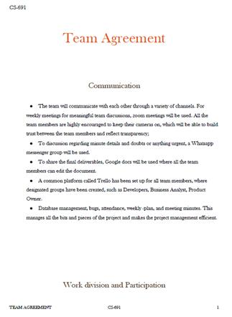
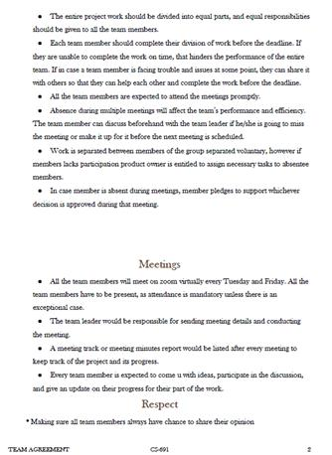
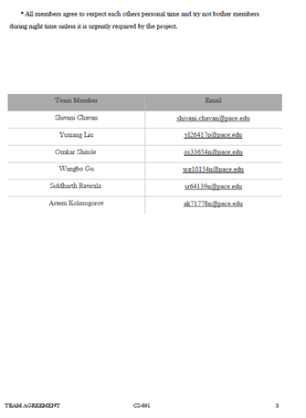
Teamwork agreement
SUBTITLE HERE

Slide 8
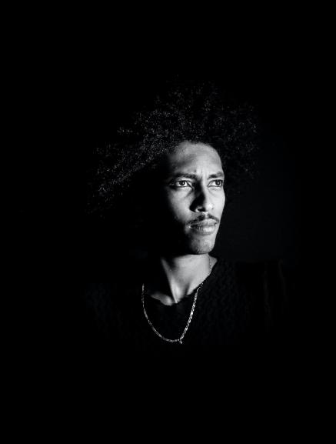
Personas
Jack
Profile
Jack, a 35-year-old software engineer who has a history of depression and anxiety. He often finds himself feeling overwhelmed at work and is struggling to balance his job and personal life. He wants to find a way to manage his symptoms so that he can be more productive and happier.
Name: Jack
Age: 35
Location: Chicago, MI
Job: Software Engineer
Salary: 92 000 – 110 000$/annually
Family: Single
Interests
Frustration
Goals
Riding Bike
Goes Kayaking
Attending live concerts
Managing depression
Wants to change job, but unable
Moving to south
Finding friends
Buying a bigger house

Slide 9
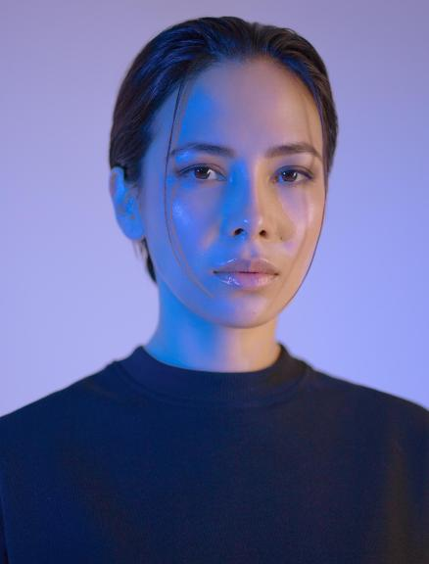
Personas
Sarah
Profile
Sarah, a 25-year-old graphic designer who has been feeling down for the past few months. Despite her successful career and supportive friends and family, she feels unfulfilled and struggles to find joy in her everyday life. She wants to find a way to manage her depression and is open to using technology to help her do so.
Name: Sarah
Age: 25
Location: Los Angeles, CA
Job: Graphic Designer
Salary: 66 000 – 70 000$/annually Family: Single
Interests
Frustration
Goals
Writing own comic books
Everyday swimmer
Loves animals
Watching series
Traffic in Los Angeles area
Living alone for a long time
Buying her own house
Building lifelong relationships
Finding friends

Slide 10

Personas
Lisa
Profile
Lisa, a 40-year-old stay-at-home mom who is feeling overwhelmed and exhausted. She is struggling to keep up with the demands of taking care of her children and household, and she often feels like she is failing as a mother. She wants to find a way to manage her stress and feelings of inadequacy.
Name: Lisa
Age: 40
Location New-York, NY
Job: Unemployed
Salary: N/A
Family: Married, two kids
Interests
Frustration
Goals
Reading romantic novels
Going for beach holidays
Loves animals
Watching series
Her husband going for a long business trip
Having troubles with her kids
Taking dog from shelter
Helping kids with college

Slide 11

Personas
Tom
Profile
Tom, a 50-year-old small business owner who is feeling stressed and burnt out. Despite the success of his business, he is feeling overwhelmed by the responsibilities and pressure of running it. He wants to find a way to manage his stress and anxiety so that he can enjoy his success and have a better work-life balance.
Name: Tom
Age: 50
Location: Austin, TA
Job: Self-Employed
Salary: 150 000 $/annually
Family: Divorced
Interests
Frustration
Goals
Going hunting & fishing
Taking rides in his chopper
Declining business profits
Having health problems
Building strong portfolio for his 401-k
Finding new friends

Slide 12
MVP, Technologies & Algorithms

Slide 13
Minimal Viable Product
Home Page
Profile/History of Consultation
A welcome message that briefly introduces the app and its purpose
A button or link to create an account or log in if you already have one
A list of features and resources available within the app, such as self-assessment questionnaires, mood trackers, and mental health resources
A prominent call-to-action encouraging users to take a self-assessment or start tracking their mood
A section where you can edit your personal information, such as your name, email address, and password

Slide 14
Minimal Viable Product
Image upload/Take Picture
Recommendation
A camera button that allows you to take a picture directly within the app
A gallery button that allows you to upload pictures from your camera roll
An option to add captions or notes to each image, to help you remember important details or context
A dashboard that displays any recommendations or next steps based on your self-assessment results, including suggestions for lifestyle changes, self-care practices, or professional treatment options

Slide 15
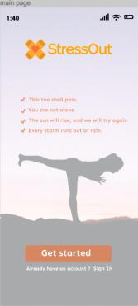
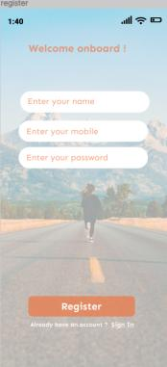
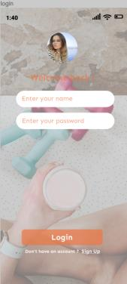
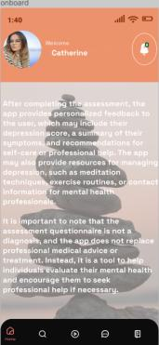
Prototype

Slide 16
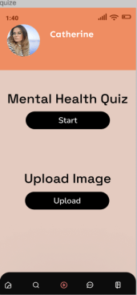
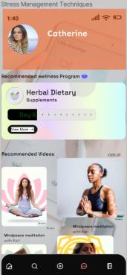
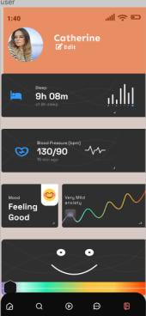
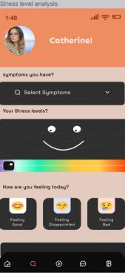
Prototype

Slide 17







Algorithms & Technologies

Slide 18

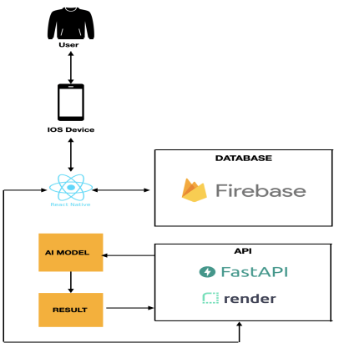
Conceptual Architecture Diagram

Slide 19

Sequence Diagram
Face Recognition
Capture Face Image
Send image for analysis
Analyze image
Return Analysis
API
Open App
Display Instruction
Display Camera Viewfinder
Position Face
Display Progress indicator
Display Result
Display History
Stress out app
Choose Action
Perform action
Click “View History”
Click “Delete History”
Confirm action
Delete History
Open App
Click “Open Test”
Click “Start Test”
User

Slide 20
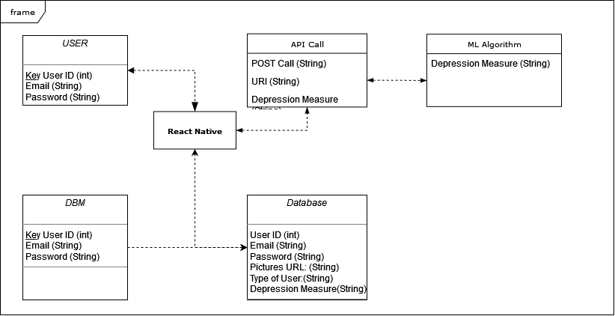
UML class diagram

Slide 21
Machine Learning API
API ready to deploy
Setting up Render environment
Solving Libraries incompatibility
Deploy the API

Slide 22
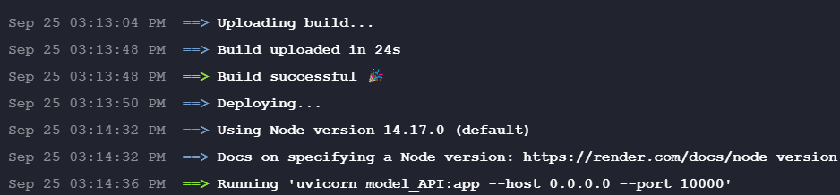
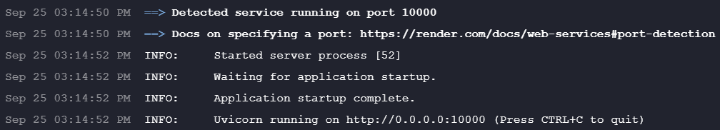
Machine learning API

Slide 23
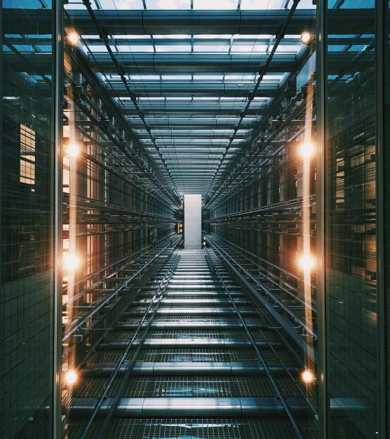
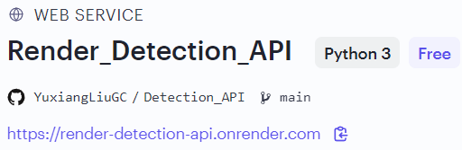
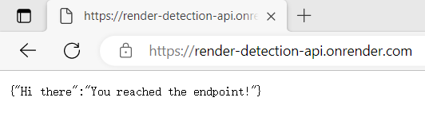
Machine learning API

Slide 24
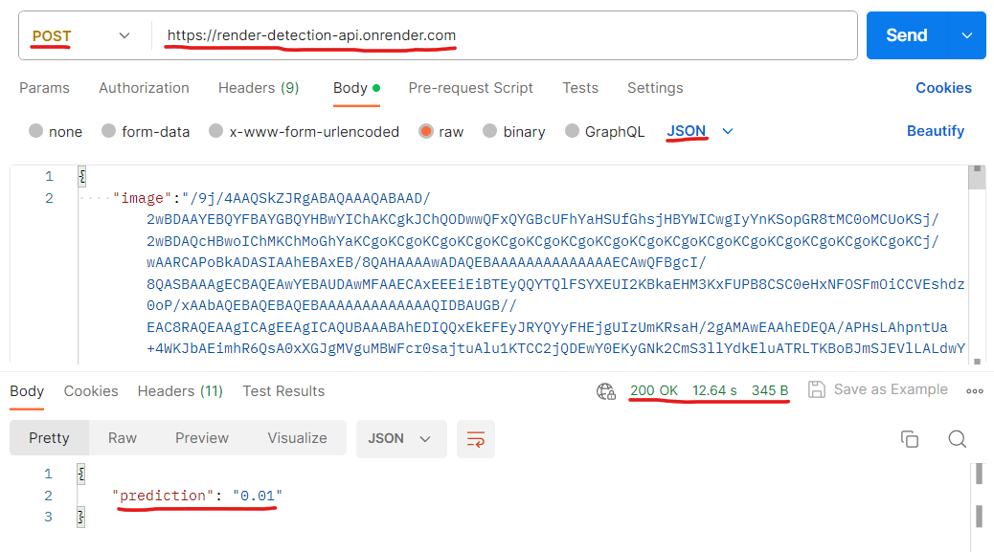
Machine learning API

Slide 25
Sprint 5 Recap
Issue type | Key | Name
STRES-36 | task | Implemented a functionality to the app that permits users to upload images.
STRES-39 | story | As a user, I would like the ability to upload images to save them and assess my depression levels.
STRES-48 | story | As a user, I want guidance on the ways to prevent my depression from worsening.
STRES-50 | task | Connected App with firebase Storage where the raw images uploaded by the users were stored.

Slide 26
Sprint 5 Recap
User Stories
Key | Summary | Place
STRES-19 | As a user, I want to register myself to the application. So that I can keep my account private and login using email/phone and password. | Home Page
STRES-20 | As a user, I want to login in app. So that I can use it to store all my information. | Home Page
STRES-42 | As a user, I want to upload my picture from phone gallery to analyze so that get more accurate information. | Image Upload/Take Picture
STRES-22 | As a user, I want to take a picture from my front and back camera to upload so that the app can analyze | Image Upload/Take Picture
STRES-23 | As a user, I want to view my upload history and their results | Profile/History of consultation
STRES-24 | As a signed in user, I want to log out So that I can have my privacy in the app. | Logout/Login
STRES-25 | As a user I want to be able to find contacts for professional help | Recommendation
STRES-26 | As a user I want to be able to view history of my recommendation | Recommendation
STRES-27 | As a user, I want to create my profile So that I can store my account information. | Profile/History of consultation
STRES-28 | As a user, I want to be able to edit my information detail | Profile/History of consultation
STRES-29 | As a user I want to be able to add captions for pictures I have uploaded | Image Upload/Take Picture
STRES-30 | As a user, I want to be able to view personalized tips and strategies for managing symptoms | Recommendation
STRES-31 | As a user, I want to know the sign of depression, and the risk of depression | Recommendation
STRES-48 | As a user, I want to link to the hospital so that I can make a appointment with doctor | Recommendation
STRES-52 | As a user, I want the app to keep checking my depression level so that I know when my depression level is worse | Profile/History of consultation
STRES-34 | As a user, I want to know the risk of depression about me after I take pictures | Image Upload/Take Picture
STRES-35 | As a user, I want to know some tips for relieving depression so that I can become better | Recommendation

Slide 27
Sprint 5 Recap
Key | Name | Story points
STRES-56 | Deploy the ML model API on Render | 5
STRES-59 | Saving User details and results to the firebase database | 5
STRES-48 | improve the UI of the app | 5
STRES-55 | Saving User Images to the firebase storage | 5
STRES-54 | Upload images from phone | 5

Slide 28
Acceptance criteria
Scenario | Summary | Status
1. customers want to see their pictures Given I’m in the role of customer When I open the file page Then I click the picture file And I can see all the pictures i upload and take | As a customer I want to check my pictures I took before so that I can see how I've changed these days | Done
2. customers want to see their past result Given I’m in the role of customer When I open the history page Then I want to see the quiz result I took before And I click the quiz result Then I can see the grades and date | As a customer I want to check my grade of the quiz so that I can know my depression level at that time | Done

Slide 29
Acceptance criteria
Scenario | Summary | Status
3. customers want to upload the pictures Given I’m in the role of customer When I open the app Then I want to upload the picture from my phone And I click the upload button Then I can select the picture from photo library | As a customer I want a picture from my Mobile photo library so that I don’t need to take picture and choose the one I want to upload | Done
4. customers want to add notes on the pictures Given I’m in the role of customer When I open the app Then I want to add notes on the pictures And I click the gallery button Then I can select one of the pictures from it and add | As a customer I want to add notes on the picture from the gallery so that I remember important details and context | Done

Slide 30
Test cases
Test case for | Key | Test data | Expected results | Actual results | Pass/fail
Image upload page | STRES-54 | email:test@gmail.com password:test123 | Customers can see their pictures from the app | Click the upload button, the page show the photo library | P
Image upload page | STRES-55 | email:test@gmail.com password:test123 one of the photo from phone | Customers can select one of their pictures and upload | Select the picture,click the upload button, show upload successful | P
History page | STRES-59 | email:test@gmail.com password:test123 one of the photo from phone | Customers can check their pictures | Click the history and click pictures, show all the previous pictures | P
History page | STRES-59 | email:test@gmail.com password:test123 quiz grade | Customers can check the past result | Click the history and click other details, show the previous quiz grade | P
Take picture page | STRES-55 | email:test@gmail.com password:test123 | After customers take pictures, pictures will be stored and found | Take the picture, it showed in history and can be found in firebase storage | P

Slide 31
Test cases
Test case for | key | Test data | Expected results | Actual results | Pass/fail
Take picture page | STRES-56 | email:test@gmail.com password:test123 | After the photo is taken, customers can see if they are at risk for depression | Click the take picture button, after loading the page show the result of depression | p
Image gallery | STRES-55 | email:test@gmail.com password:test123 one of the photo from phone Note:holiday | Customers can add captions or notes to each image | click the gallery button,pick one of them and successfully add note” holiday” | p

Slide 32
Completed and not completed Stories
Key | Name | Status
STRES-56 | Deploy the ML model API on Render | Done
STRES-59 | Saving User details and results to the firebase database | Done
STRES-48 | Improve the UI of the app | In processing
STRES-55 | Saving User Images to the firebase storage | Done
STRES-54 | Upload images from phone | Done

Slide 33
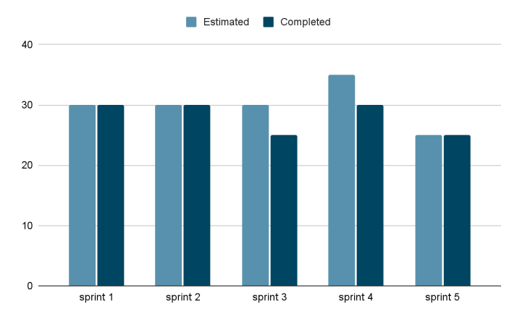
Team Velocity

Slide 34
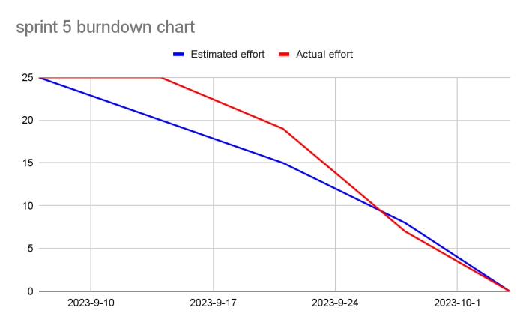
Sprint 5 Burndown Chart

Slide 35
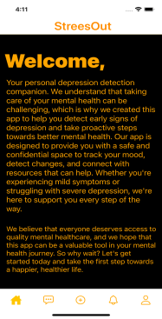
App Screenshots
Home Page
App has 5 Functionality Buttons
Onboarding Screen: A screen that welcomes the user to the app and provides an overview of its app.
Stress level analysis screen: A screen that displays the user's stress level based on the biometric data collected.
Quiz / Upload Images Screen: Quiz screen that asks the user questions to identify their sources of stress. Upload screen that allows the user to upload images
Stress management techniques Screen: A screen that provides stress management techniques, such as breathing exercises, meditation, or cognitive behavioral therapy.
Registration / Login Screen: A screen that allows the user to create an account or log in to an existing one.

Slide 36
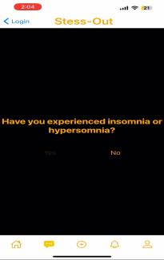
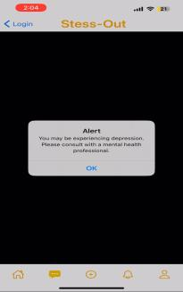
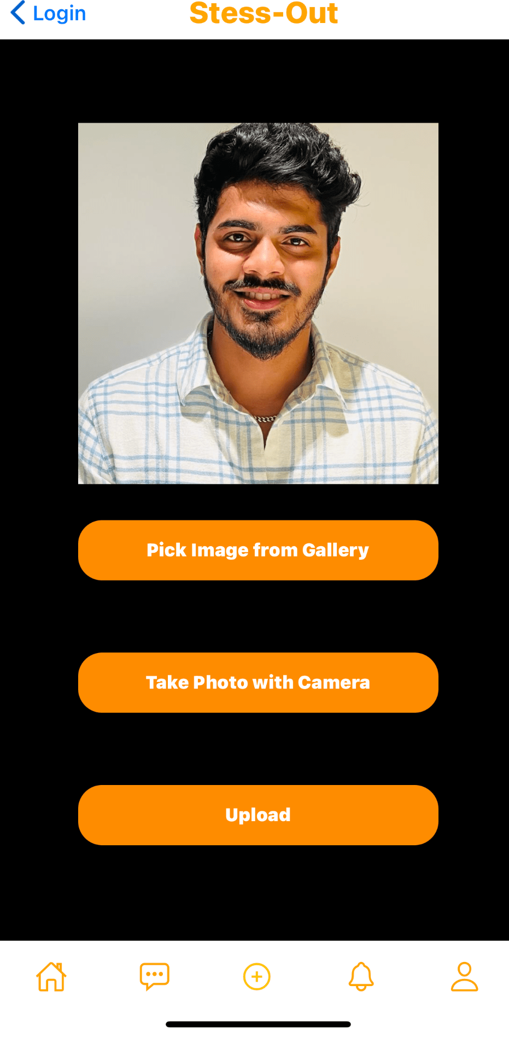
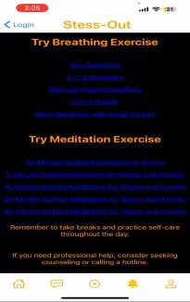
App Screenshots

Slide 37
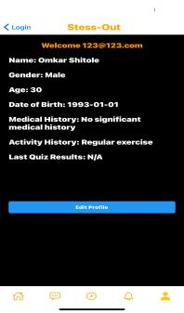
User Details
Profile Screen
In this screen user can edit and save profiles information like name, gender, age, DOB, medical history, and activity history.
User quiz results are saved in real-time to a Firestore database as part of their profile data.
The app's profile screen provides a comprehensive overview of the user's personal information and quiz results, aiding in stress assessment.
By combining facial recognition technology and profile data storage, the app aims to offer effective stress detection and management.

Slide 38
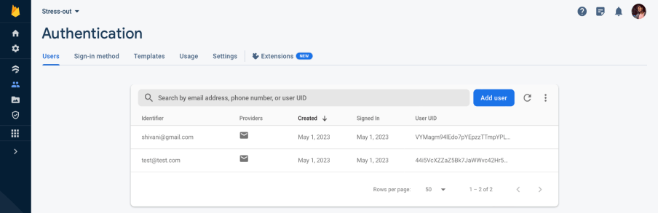
Firebase Authentication
When a new user creates an account using Firebase Authentication in our app, the user's email address and a unique user ID (UID) are automatically generated and stored securely in the Firebase Authentication server.

Slide 39
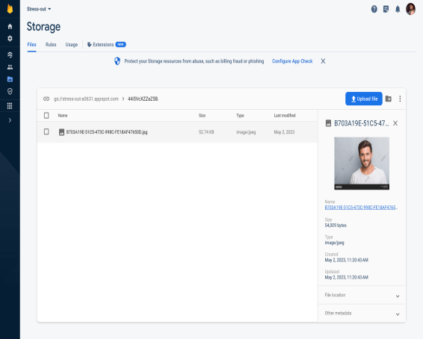
Firebase Authentication
When a user uploads or takes a picture in our app, the image is stored in Firebase Storage using the Firebase Storage client SDK. To maintain a separation between different users' data, we create a separate folder for each user in Firebase Storage, with the user's UID associated with that folder. This ensures that each user's data is stored in separate location. Firebase Storage generates a unique URL for each file that is stored, which can be used to retrieve the file later.

Slide 40
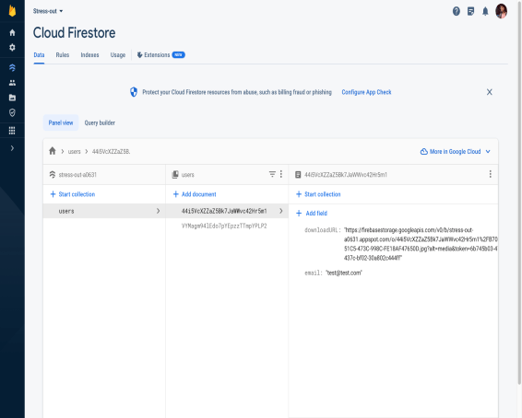
Firebase Authentication
When a user signs up for the app, we create a new document for the user in the in the collection called users in firestore database using the Firebase Authentication UID as the document ID.
The image which is uploaded to a Cloud Storage bucket under a unique file name that includes the user's UID and the current timestamp. The getDownloadURL method is used to obtain a download URL for the uploaded file. Finally, the user's document in Firestore is updated with the URL of the uploaded image.

Slide 41
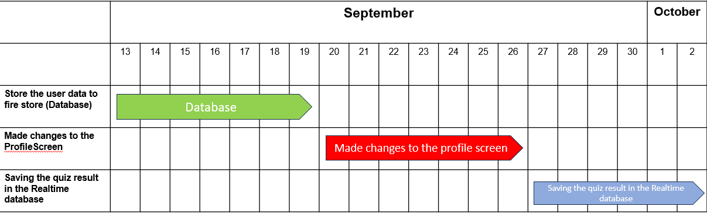
Sprint 5 Schedule

Slide 42
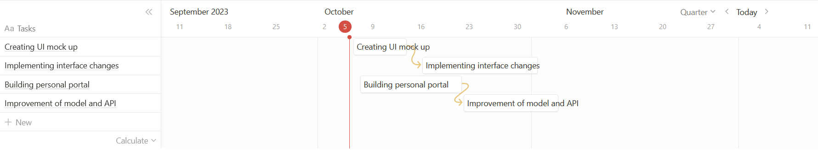
Sprint 6 Schedule

Slide 43

Retrospective
What went well: Team collaborated effectively with each other. Despite short sprint team managed to find solution for API issues we have had with our application. All changes were introduced in timely manner allowing team members to cross check each other’s work
What needs improvement: We need to investigate cutting number of slides and reducing the length of presentation. Currently we have over 48 slides which makes presentation lengthy and difficult to render and upload to wiki.
Next Steps: We are going to change the front-end side of the application to improve UI and user perception,

Slide 44

Thank you
CS-692
Team 2: Bug Terminator
Depression Detection System
Github Link

